Slide 1
SOFTWARE DEFINED NETWORK FIREWALL
Amol Vaze
Dayana Rajiah Stalin
Jayprakash Patel
Mohit Mittal
Prathyusha Gunukula
Sridevi Balaga

Slide 2
OVERVIEW
Objective
Platforms Used
Network Topology
Procedure
Demo

Slide 3
Objective
To add a firewall on the POX controller that specifies which IP addresses need to be blocked.
Application written in Python and run on top of POX controller.
Emulation of network topology containing switches and end hosts in mininet.

Slide 4
Platforms Used
POX Controller
POX-a networking software platform written in Python.
POX provides a framework for communicating with the SDN switches using OpenFlow protocol.
Pythonic OpenFlow interface.
Runs anywhere(mostly under Linux, Mac OS, Windows).

Slide 5
Platforms Used
Mininet
It is a network emulator.
It runs a collection of end-hosts, switches, routers, and links on a single Linux kernel.
Advantages – Fast, can create custom topologies, customize packet forwarding, can run real programs, open source project.

Slide 6
Network Topology
Controller
Port 6633
dpctl
OpenFlow Switch
h1
h2
h3
Notes:
Dpctl: It enables control over the open flow switch.

Slide 7
Procedure
Rules are added to the controller to drop packets with certain source and destination IP addresses.
IP address pairs are provided in CSV file format and these pairs are read and processed into Python by pox.
Firewall takes IP pair list as input and install it on the switches in the network.

Slide 8
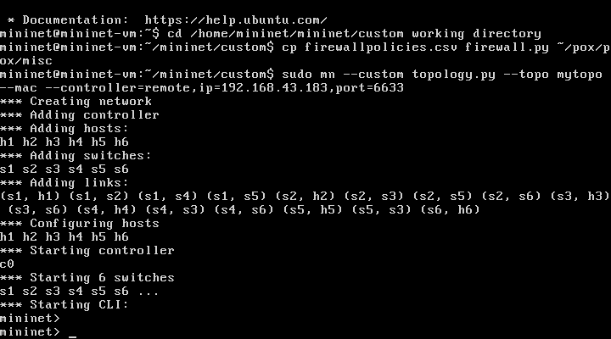
Demo

Slide 9
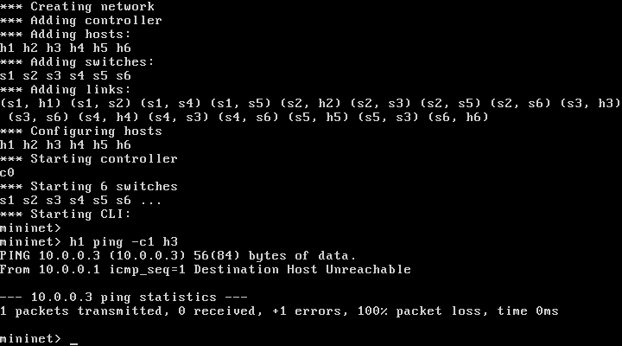

Slide 10
REFERENCES
https://www.usenix.org/system/files/conference/ons2014/ons2014-paper-hu_hongxin.pdf
https://openflow.stanford.edu/display/ONL/POX+Wiki
http://sdnhub.org/tutorials/pox/
http://www.noxrepo.org/pox/about-pox/

Slide 11
THANK YOU

